Slide 1
Raising Funds & Support for your School Garden
Presenter : Tammy Freeman
Caughlin Ranch Elementary School Garden Coordinator
Date: 1/14/2017

Slide 2
Speaking Points
My Background
School Garden Prep Work
Fundraising at the School Level
Community Partnerships
Grants
CRES School Garden

Slide 3
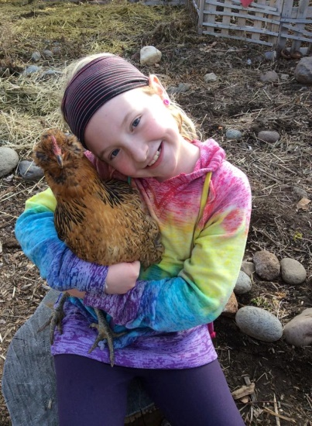
My Background
Mother of 11 year old
Inspired by my daughter to put in a garden area.
No gardening experience
Involved with school fundraising at the PFA level.
Volunteer Art Teacher at CRES
Advocate for outdoor education

Slide 4
School Garden Prep Work
Gain support from your Principal.
Attend staff meetings.
Attend PFA meetings.
Talk to students and families.
Work with WCSD Remodel Department on School Garden Proposal and obtain approval BEFORE starting your project.

Slide 5
Fundraising at the School Level
Garden Bingo Night
Skate Nights at Roller Kingdom
Yogurt Beach Give Back Days
Restaurant Give Back Night Partners: Chilis, Eclipse Pizza, La Cucina, Red Robin, Java Ship Coffee Truck
I Dig School Garden T-Shirt Sales

Slide 6
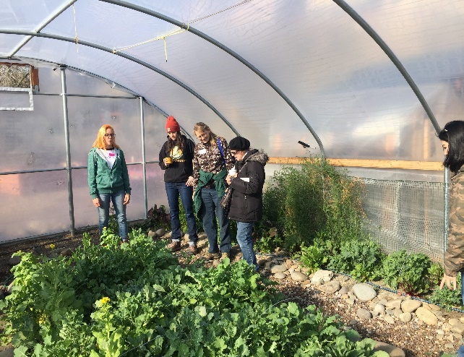
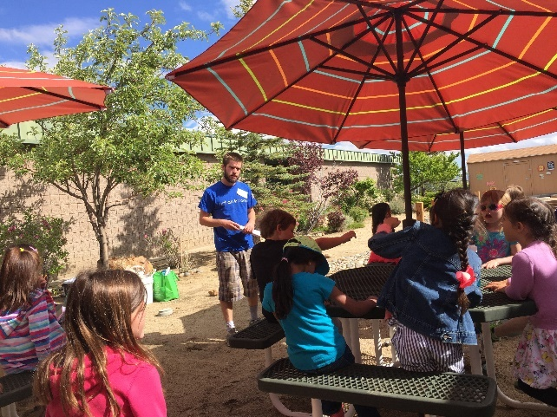
Community Partners Urban Roots
Pre-garden support
PFA fundraising supports program.
Fall/Spring Program
10 Week Program for all grades including special needs students.
5 total classes per classroom held in the garden area.
Working towards getting students and staff to take ownership of the area.

Slide 7
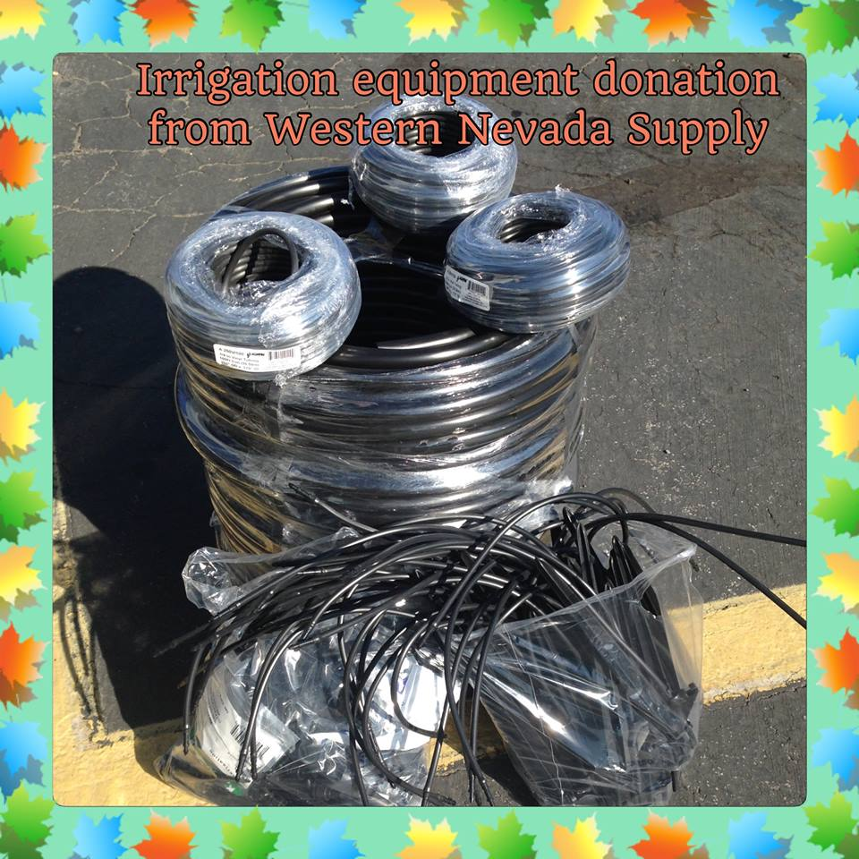
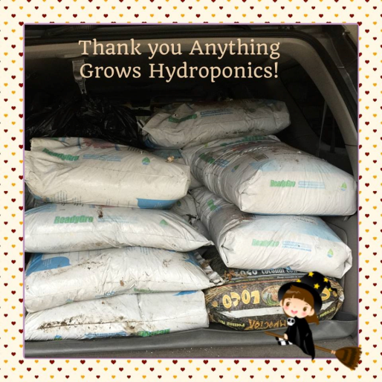
Western Nevada Supply & Anything Grows Hydroponics

Slide 8
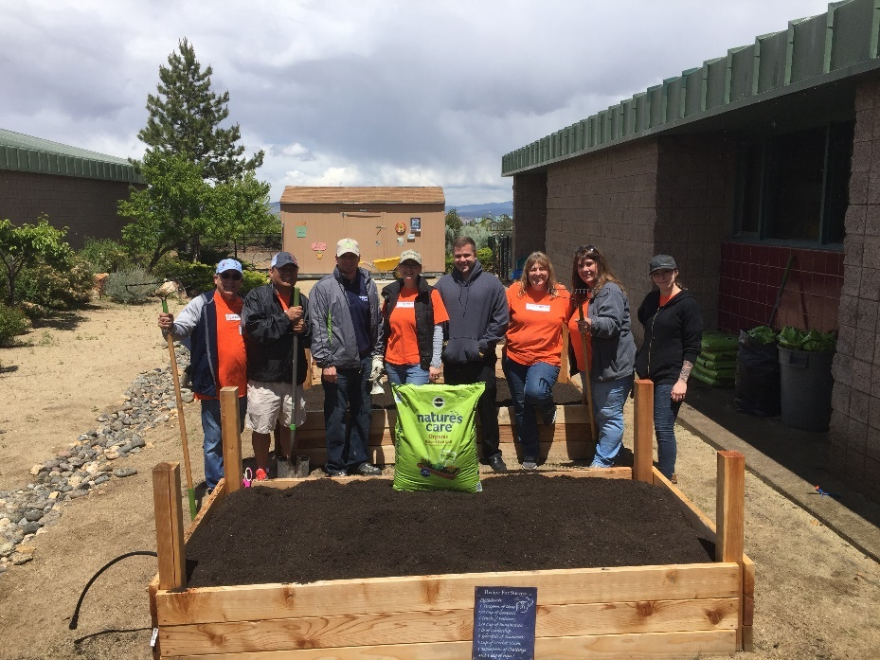
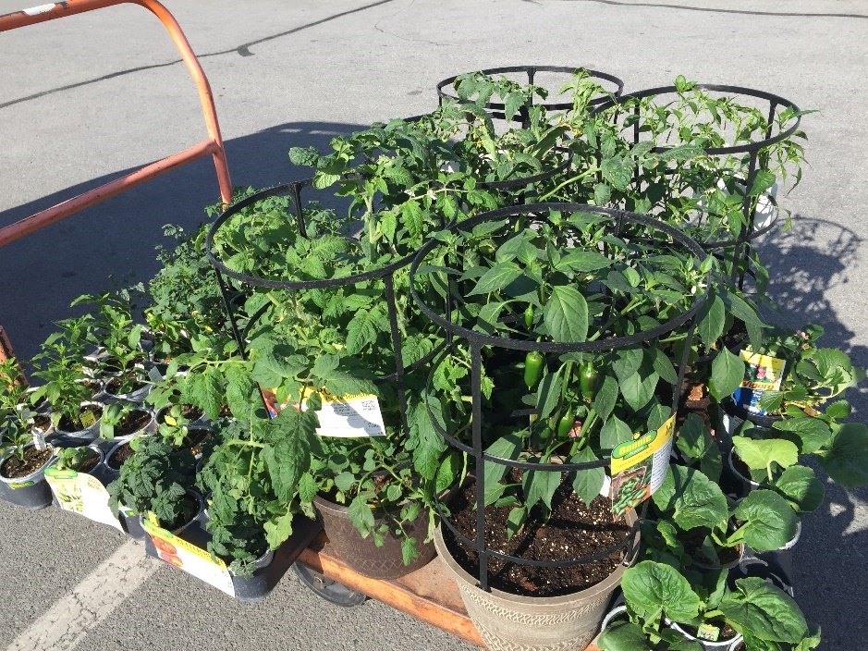
Home Depot & Scotts Lawn

Slide 9
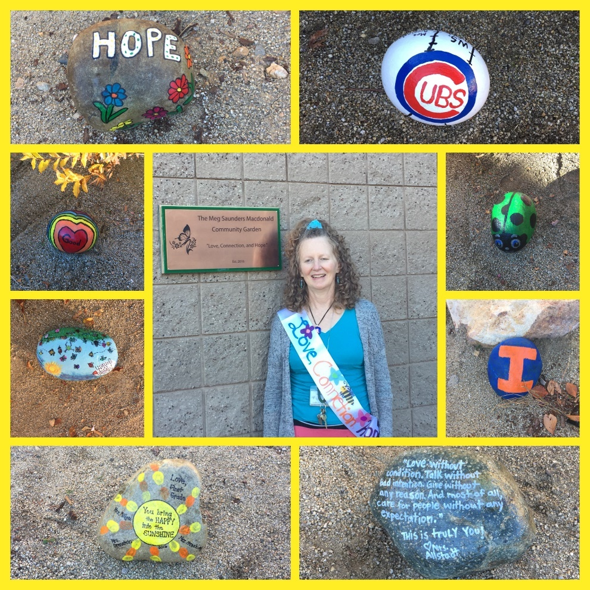
Oxborro Landscaping Materials

Slide 10
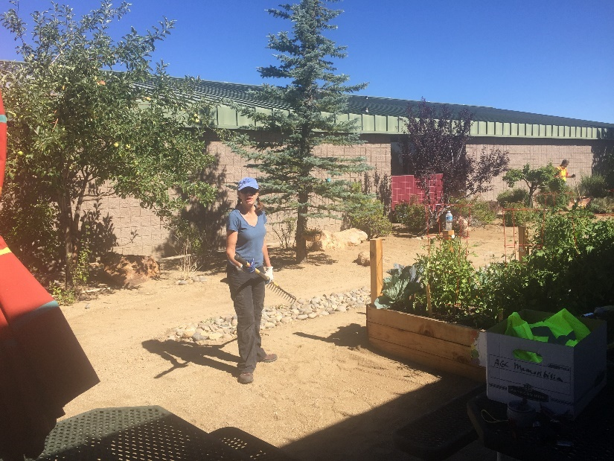
Department of Fish & Wildlife
Worked with Michelle Hunt on planning and installing a Native Pollinator Habitat adjacent to our school garden.
Dept. of Fish & Wildlife met with WCSD officials and obtained approval for the installation of over 90 blooming plants native to the Great Basin area.

Slide 11
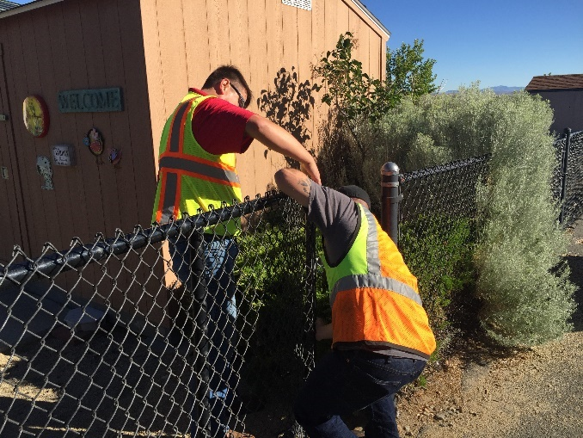
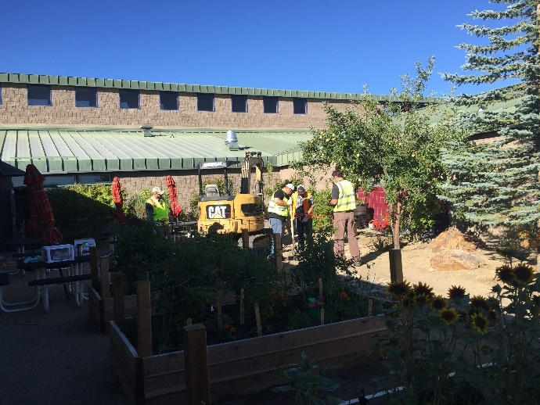
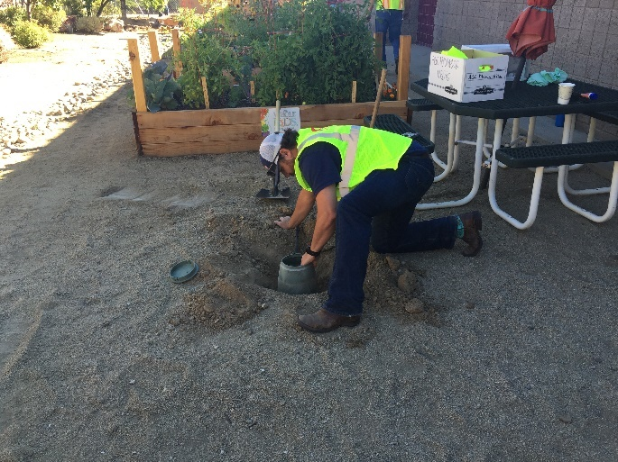
Nevada Chapter AGC

Slide 12
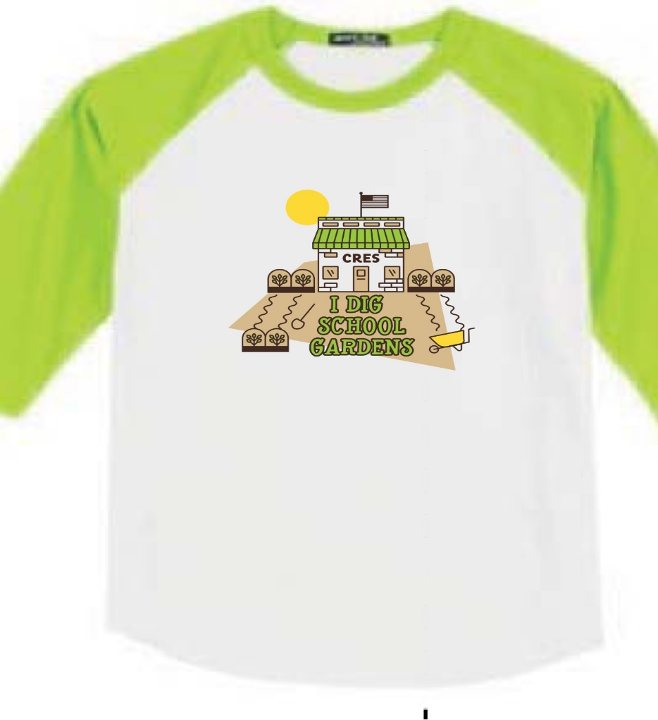
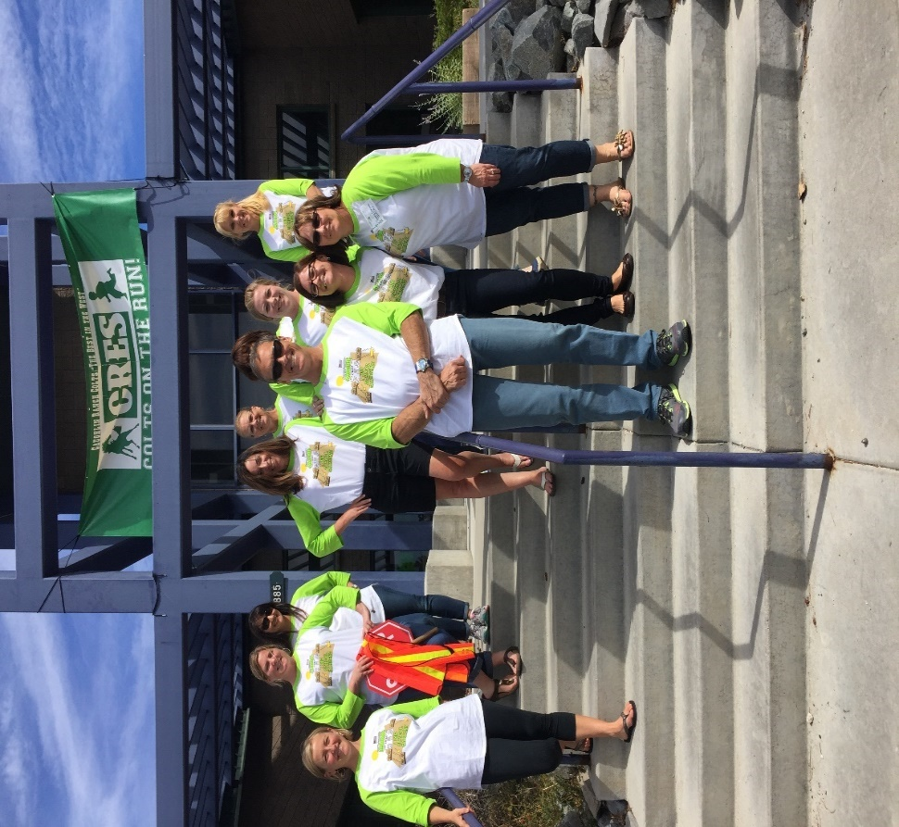
Laxalt & McIver

Slide 13
Grants
Submit completed & signed WCSD grant form to grant department for approval, if you are applying under your school’s FEIN number. Form can be pulled up WCSD website.
Marianne Reger, WCSD Grant Writer, 775-348-0356
Non-profit Parent Teacher Associations (PTA/PFA) can submit grants directly without seeking WCSD approval.
STAY POSITIVE AND DON’T TAKE REJECTION PERSONAL.

Slide 14
CRES Applied for several grants including the following:
Annie’s Homegrown- REJECTED
Jamba Juice- REJECTED
Karma for Cara Micro Grants (students can apply)- REJECTED
Lowes Toolbox- REJECTED
Natures Everywhere- REJECTED
Reading is the Way Up- AWARDED!!
Whole Kids Garden- AWARDED!!

Slide 15
Whole Foods Kids- $2,000

Slide 16
Reading is the Way Up http://readingisthewayup.org/program-funds-2/ AWARDED: $1,500

Slide 17
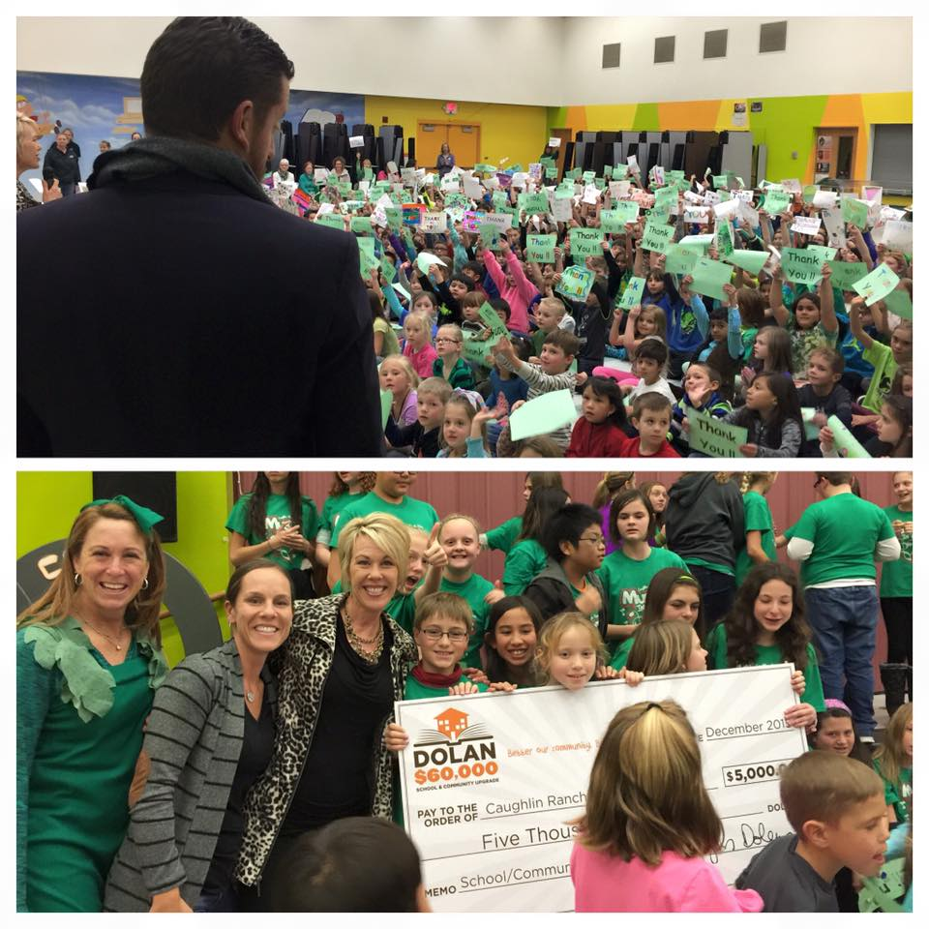
Dolan Auto Group Class Project
$60,000 will be divided amongst 12 classrooms. Four elementary, Four middle and Four High School classrooms will each receive $5,000.
Funds are intended to go directly to the classroom putting in the work vs. to the school.

Slide 18
Judging Criteria
Each classroom's project will be anonymously graded by designated community members based on the following criteria. We will ask the appointed judges to grade each segment of the project on a 1 to 10 point scale.
This project had a positive impact on members of our community and/or environment
There were measurable results
This project was creative
This project was promoted and shared throughout the school and/or community
Student involvement was maintained throughout all aspects of the project
This project allowed students to learn about the importance of giving back
This project incorporated community involvement

Slide 19
Submissions
Classrooms will need to submit the following information by the deadline provided:
An explanation of their project (no longer than one page)
Video (no longer than 2 minutes) of their project (mp3 format)
Measurable Results (How many items did you collect? How many people did you impact? What improvements did you make? Etc.)
Explanation of how you promoted/executed your project.
How many children from your class assisted in the project?
What will your classroom use the $5,000 for?
Provide 2-3 pictures of the children in your classroom engaging in the project.

Slide 20
Timeline
March 6, 2017: Submissions Due
March 13, 2017: Judges are provided with the information needed to determine their grading criteria.
March 14, 2017: Winners announced via Dolan Auto Group's Facebook page and posted on DolanAutoGroup.com. Checks will be delivered by Dolan Auto Group AFTER Spring Break.
Contact Info: Ashton Hutton 775-384-5217
https://www.dolanautogroup.com/dolan-difference/community/Class-Project/2017.htm

Slide 21
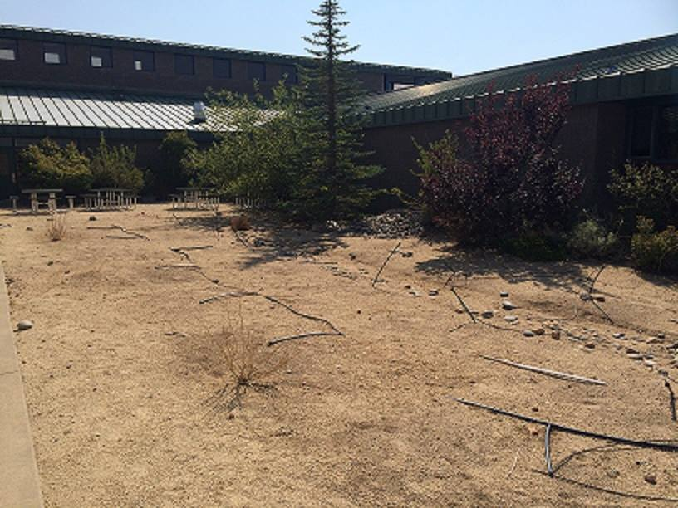
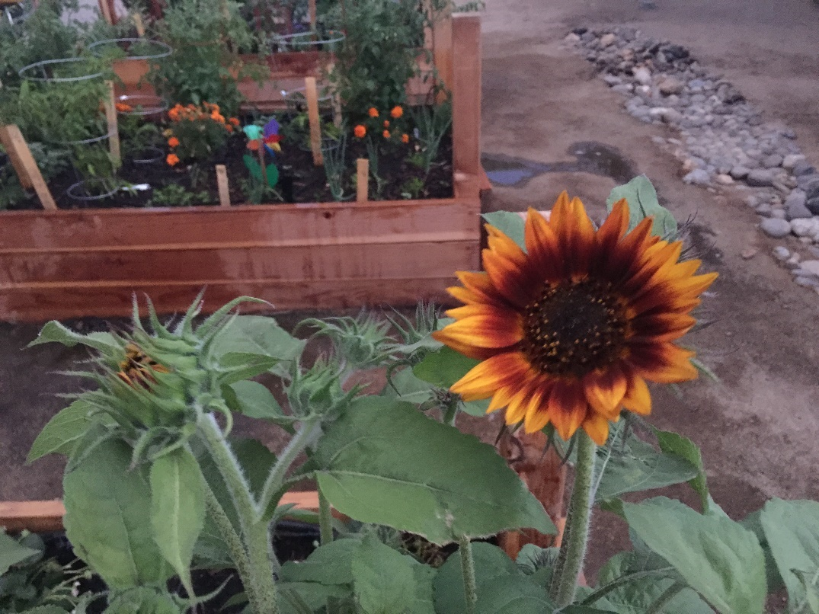
CRES School Garden
4 raised garden beds 4ft x 8ft
Native Pollinator Habitat approximately 1,700 sqft & over 90 native plants.

Slide 22
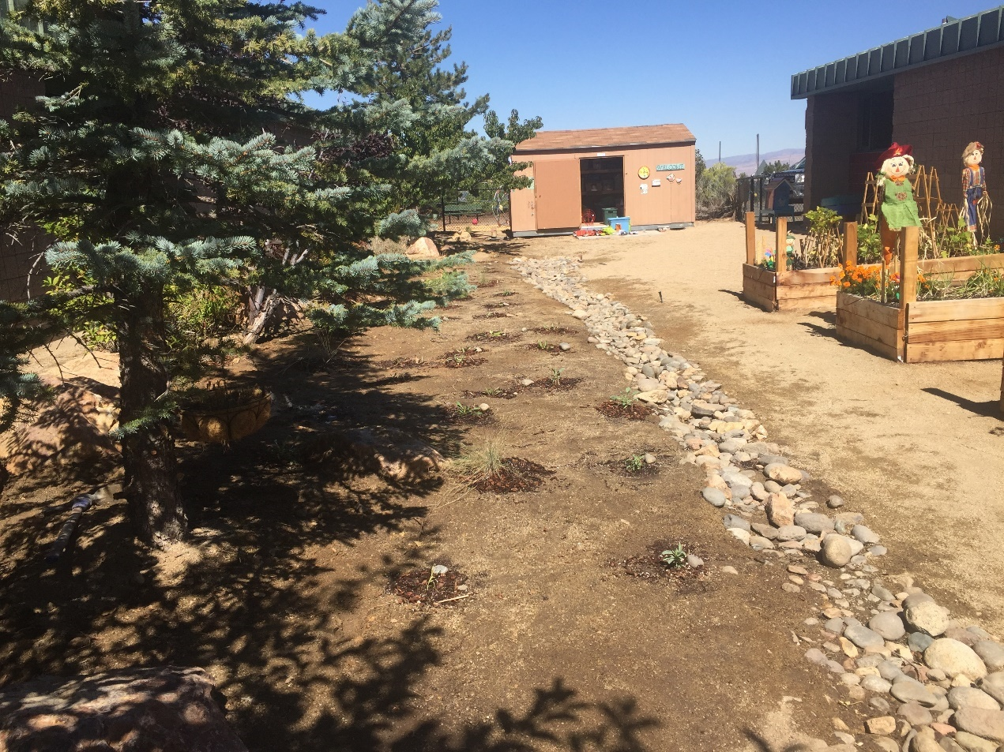
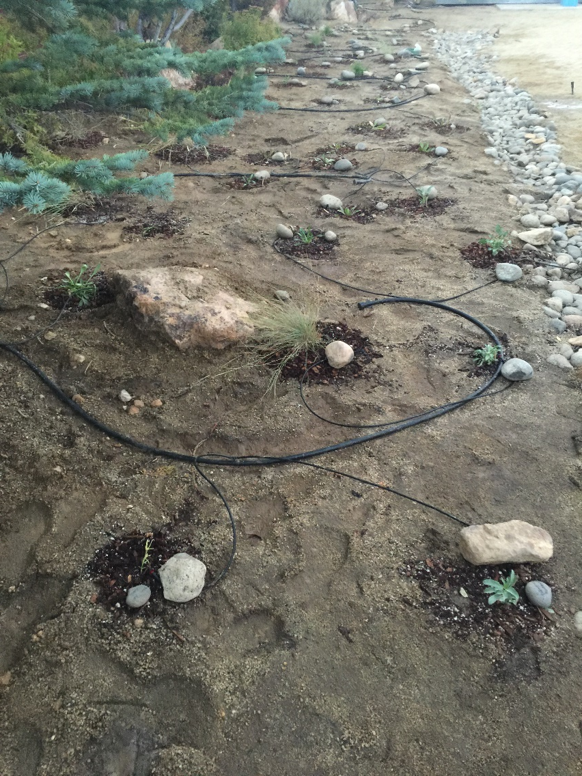

Slide 23
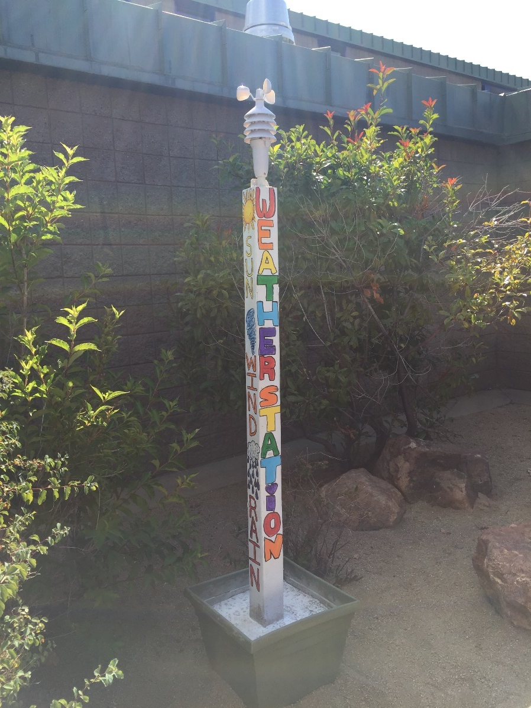
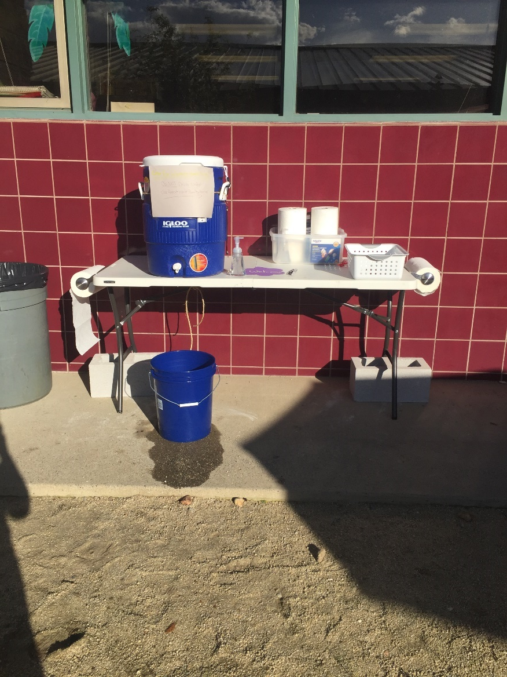

Slide 24
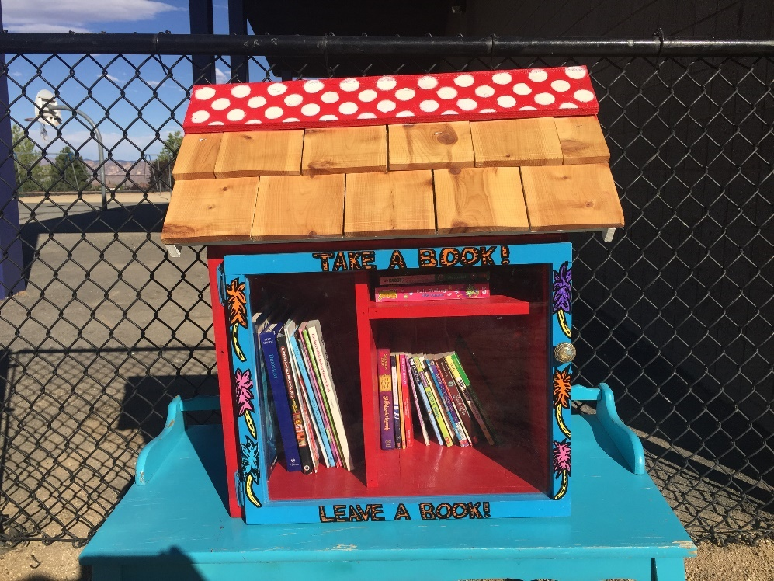
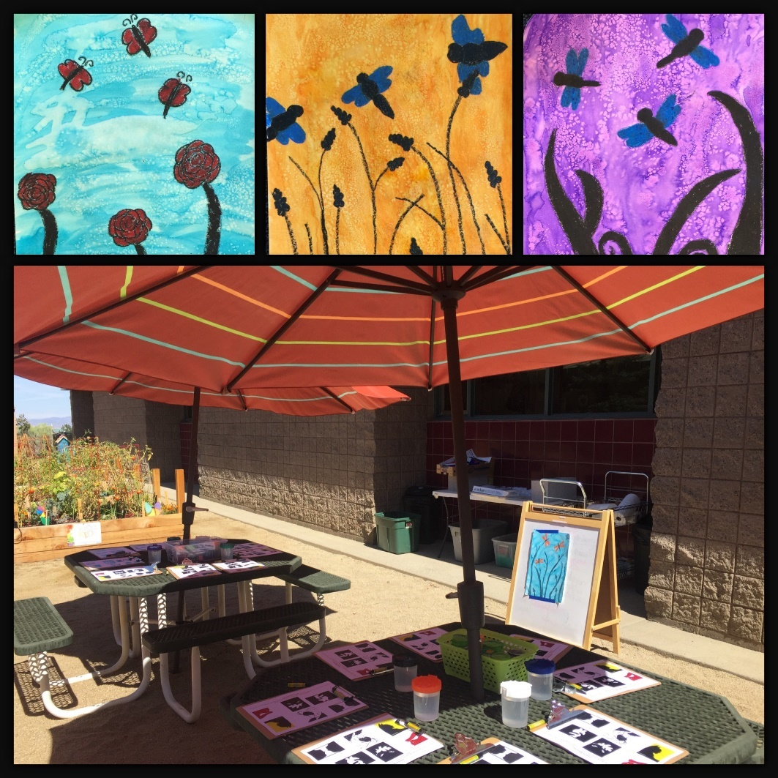

Slide 25
